Slide 1
Interest Rates and Bond Valuation
7
Prepared by Anne Inglis, Ryerson University
Notes:
6.<number>

Slide 2
Bond Valuation Week 5:Summer 2019
7-<number>

Slide 3
Key Concepts and Skills
Know the important bond features and bond types
Understand bond values and why they fluctuate
Understand bond ratings and what they mean
Know how bond prices are quoted
Understand the impact of inflation on interest rates
Understand the term structure of interest rates and the determinants of bond yields
7-<number>
Notes:
6.<number>

Slide 4
Present Value of Cash Flows as Rates Change
LO2
Bond Value = PV of coupons + PV of face
Bond Value = PV annuity + PV of lump sum
Remember, as interest rates increase the PV’s decrease and vice versa
So, as interest rates increase, bond prices decrease and vice versa
7-<number>
Notes:
6.<number>

Slide 5
Valuing a Discount Bond with Annual Coupons
LO2
Consider a bond with a coupon rate of 10% and coupons paid annually. The par value is $1000 and the bond has 5 years to maturity. The yield to maturity is 11%. What is the value of the bond?
  Using the formula:
    B = PV of annuity + PV of lump sum
    B = 100[1 – 1/(1.11)⁵] / .11 + 1000 / (1.11)⁵
    B = 369.59 + 593.45 = 963.04
  Using the calculator:
    N = 5; I/Y = 11; PMT = 100; FV = 1000
    CPT PV = -963.04
7-<number>
Notes:
6.<number>
Remember the sign convention on the calculator. The easy way to remember it with bonds is we pay the PV (-) so that we can receive the PMT (+) and the FV(+).
Slide 7.8 discusses why this bond sells at less than par.

Slide 6
Valuing a Premium Bond with Annual Coupons
LO2
Suppose you are looking at a bond that has a 10% annual coupon and a face value of $1000. There are 20 years to maturity and the yield to maturity is 8%. What is the price of this bond?
  Using the formula:
    B = PV of annuity + PV of lump sum
    B = 100[1 – 1/(1.08)²⁰] / .08 + 1000 / (1.08)²⁰
    B = 981.81 + 214.55 = 1196.36
  Using the calculator:
    N = 20; I/Y = 8; PMT = 100; FV = 1000
    CPT PV = -1196.36
7-<number>
Notes:
6.<number>

Slide 7
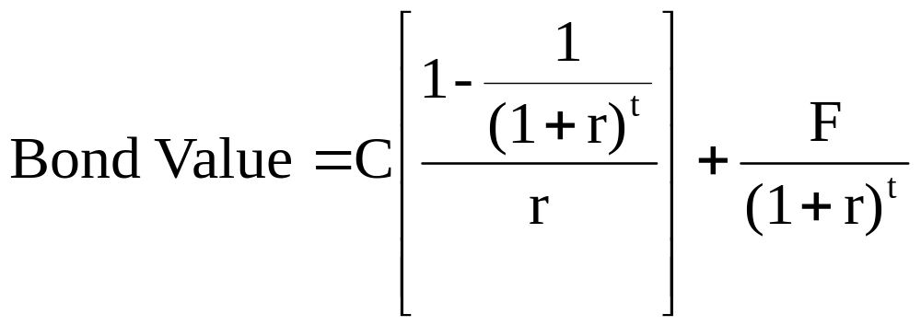
The Bond-Pricing Equation
LO2
7-<number>
Notes:
6.<number>
This formalizes the calculations we have been doing.

Slide 8
Example – Semiannual Coupons
LO2
Most bonds in Canada make coupon payments semiannually.
Suppose you have an 8% semiannual-pay bond with a face value of $1,000 that matures in 7 years. If the yield is 10%, what is the price of this bond?
  The bondholder receives a payment of $40 every six months (a total of $80 per year)
  The market automatically assumes that the yield is compounded semiannually
  The number of semiannual periods is 14
7-<number>
Notes:
6.<number>

Slide 9
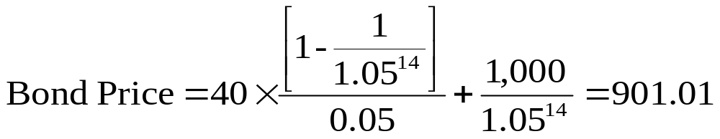
Example – Semiannual Coupons continued
LO2
  Or PMT = 40; N = 14; I/Y = 5; FV = 1000; CPT PV = -901.01
7-<number>
Notes:
6.<number>

Slide 10
Interest Rate Risk
LO2
Arises from fluctuating interest rates
Two things determine how sensitive a bond will be to interest rate risk:
  Time to Maturity – All other things being equal, the longer the time to maturity, the greater the interest rate.
  Coupon rate – All other things being equal, the lower the coupon rate, the greater the interest rate risk.
7-<number>
Notes:
6.<number>
Emphasize that even though interest rates fluctuate in the market, the coupon rate on the bond never changes.

Slide 11
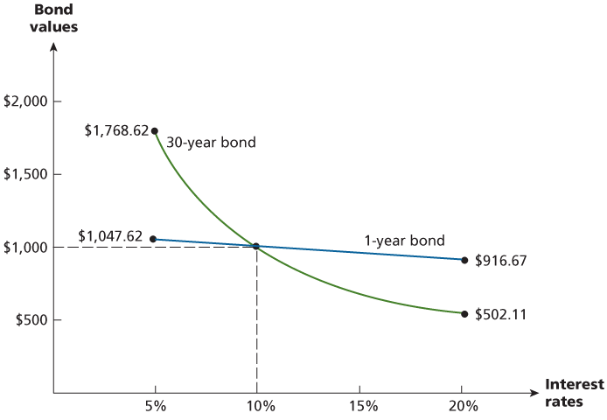
Figure 7.2 – Interest Rate Risk and Time to Maturity
LO2
7-<number>
Notes:
6.<number>

Slide 12
Computing Yield-to-Maturity
LO2
Yield-to-maturity is the rate implied by the current bond price
Finding the YTM requires trial and error if you do not have a financial calculator and is similar to the process for finding r with an annuity
If you have a financial calculator, enter N, PV, PMT and FV, remembering the sign convention (PMT and FV need to have the same sign, PV the opposite sign)
7-<number>
Notes:
6.<number>

Slide 13
Example – Finding the YTM
LO2
Consider a bond with a 10% annual coupon rate, 15 years to maturity and a par value of $1000. The current price is $928.09.
  Will the yield be more or less than 10%?
  N = 15; PV = -928.09; FV = 1000; PMT = 100
  CPT I/Y = 11%
7-<number>
Notes:
6.<number>
The students should be able to recognize that the YTM is more than the coupon since the price is less than par.

Slide 14
YTM with Semiannual Coupons
LO2
Suppose a bond with a 10% coupon rate and semiannual coupons has a face value of $1000, 20 years to maturity and is selling for $1197.93.
  Is the YTM more or less than 10%?
  What is the semiannual coupon payment?
  How many periods are there?
  N = 40; PV = -1197.93; PMT = 50; FV = 1000; CPT I/Y = 4% (Is this the YTM?)
  YTM = 4%*2 = 8%
7-<number>
Notes:
6.<number>

Slide 15
Differences Between Debt and Equity 7.2
LO3
Debt
  Not an ownership interest
  Bondholders do not have voting rights
  Interest is considered a cost of doing business and is tax deductible
  Bondholders have legal recourse if interest or principal payments are missed
  Excess debt can lead to financial distress and bankruptcy
7-<number>
Notes:
6.<number>

Slide 16
Differences Between Debt and Equity Continued
LO3
Equity
  Ownership interest
  Common shareholders vote for the board of directors and other issues
  Dividends are not considered a cost of doing business and are not tax deductible
  Dividends are not a liability of the firm and shareholders have no legal recourse if dividends are not paid
  An all equity firm can not go bankrupt
7-<number>
Notes:
6.<number>

Slide 17
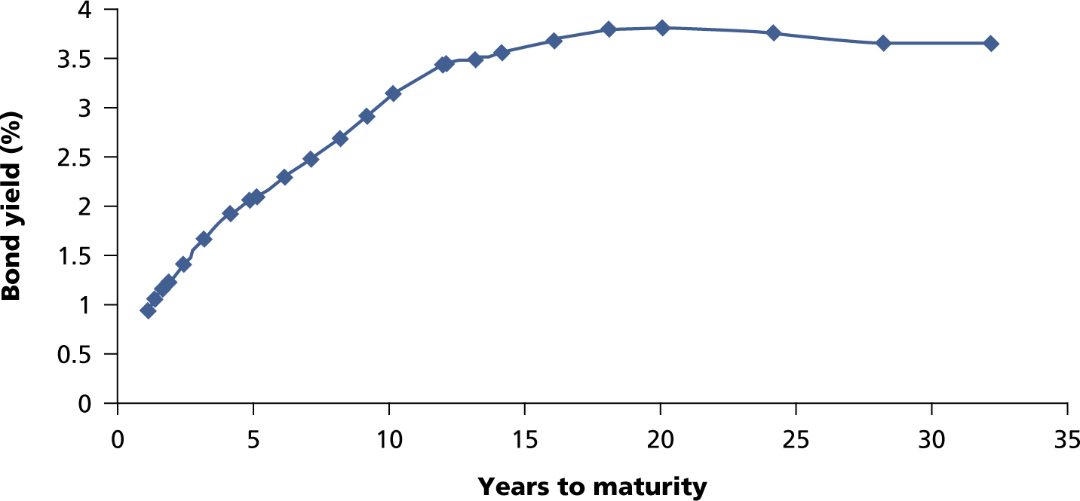
Figure 7.5 – Government of Canada Yield Curve
February 13, 2009
LO6
7-<number>
Notes:
6.<number>

Slide 18
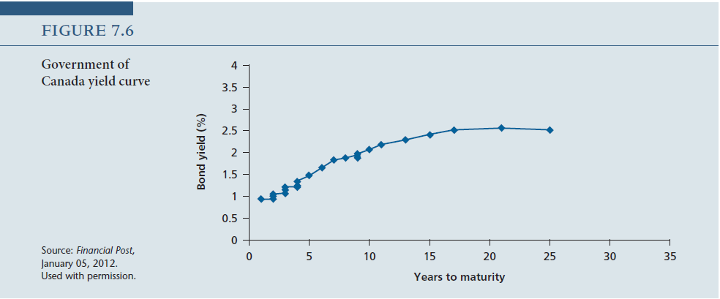
7-<number>
Notes:
6.<number>

